Slide 1
COVID VACCINE DEPLOYMENT AND ROLL OUT PLAN
HON. GEN (RETD) DR. C. G. D. N. CHIWENGA
Vice President of the Republic of Zimbabwe and
Minister of Health and Child Care

Slide 2
Background
The COVID-19 pandemic has affected the country resulting in 34 949 positive cases and 1382 deaths as of 11 February 2021
The high numbers of both positive cases and deaths has prompted the country to plan for the introduction of a vaccine
The country has already secured 200 000 doses of the vaccine which will be administered to priority groups country
In addition, an operational budget to fund the implementation of planned activities is in place and has been shared with Treasury
The country COVID-19 vaccination and deployment plan identifies key areas for successful roll out of the vaccine.

Slide 3
Objectives of the meeting
Outline the roll out plan and deployment Plan framework
To appraise stakeholders on the country state of readiness for introduction

Slide 4
Objectives of the National Roll out and Deployment Vaccination Plan
The National Roll out and Deployment and Vaccination Plan (NDVP)is a guiding document that provides a framework for:
Designing strategies for the deployment, implementation and monitoring of the COVID-19 vaccine(s) in the country
Ensuring the plan and related financing is well aligned to the Zimbabwe COVID-19 recovery and response and support plans, and that implementation is fully integrated into national governance mechanisms.

Slide 5
OBJECTIVE OF COVID VACCINATION
Broad Objective
To enable high quality vaccination services and reduce morbidity and mortality due to Covid 19 disease
Specific Objectives
To vaccinate eligible population on a voluntary basis for free
Vaccinate minimum 60% of the total population to achieve herd immunity .
To initiate vaccination through eligible high risk target populations
To provide adequate vaccines & supplies for the activity
To ensure availability of functional cold chain equipment at all levels
To monitor progress, AEFIs, and provide corrective action
Create demand for immunization

Slide 6
Regulatory Framework
The COVID-19 vaccine is an emergency vaccine registered by MCAZ under Emergency use Authority, this is in terms of section 75 of Medicines and Allied Substances Control Act.
The Pharmacovigilance and Clinical Trials Committee will implement vaccine vigilance plans to monitor the safety and eﬀectiveness of the COVID-19 vaccine in use.
The vaccine consignment shall be physically verified and cleared by MCAZ upon arrival
The consignment shall be cleared on the basis of the standard vaccine lot release documentation

Slide 7
Regulatory Framework
Ministry will set up and implement the safety monitoring plan to enable swift detection of any Adverse Events Following Immunization (AEFI
Ministry to consider a study to confirm immunogenicity of the product in the local population

Slide 8
Planning and coordination
Established (or engage an existing committee) a National Coordinating Committee (NCC) for COVID-19 vaccine introduction with terms of reference, roles and responsibilities and regular meetings
The Inter- Agency Coordinating Committee (ICC) was tasked to spearhead planning and preparations for COVID-19 vaccination.
The National COVID-19 Response Coordinator was coopted into the ICC with the Permanent Secretary being the chair of the committee.
Public Partnership initiatives will be oordinated by Ministry of Finance and Development
The MoHCC will implement effective deployment of the COVID-19 vaccines through the National EPI program

Slide 9
Resources and funding
The total estimated operational budget for COVID-19 vaccination over all phases is USD 6,778,777
The total estimated cost for phase 1 stage 1 is USD1,3 million
Budget summary for Phase 1 stage 1 and for all stages is indicated in the tables below

Slide 10
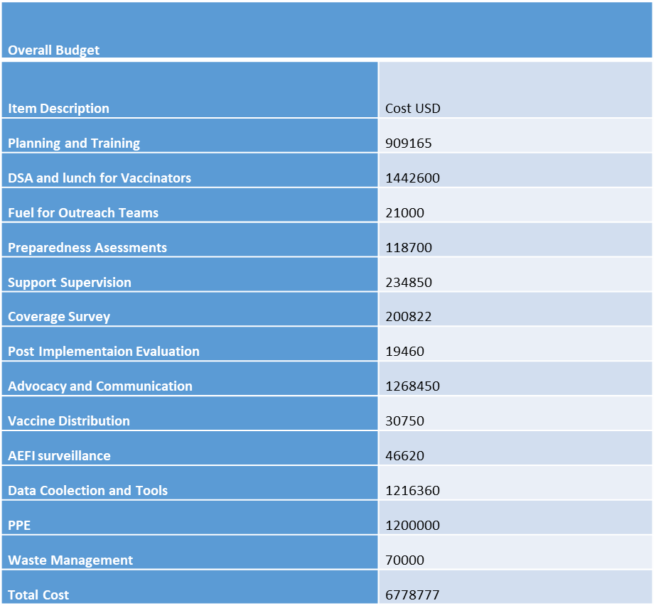
Overall Operational budget

Slide 11
Budget Breakdown for Phase 1 Stage 1
Item Description | Amount ( USD)
National Planning and Training | 2 640
Provincial Planning and Training | 45 480
Vaccination | 741 577
Supportive Supervision | 136 364
Advocacy and Communication | 262 240
Logistics Vaccine Supply and cold Chain | 14 530
Data Management | 27 678
Total | 1 202 831
Public Private

Slide 12
Target populations for Vaccinations
 | Population | % of Population
Phase 1 ( stage 1 and 2) | 3 662 279 | 22%
Phase 2 | 3 050 855 | 18.4%
Phase 3 | 3 050 855 | 18.4%
Subtotal | 9 763 988 | 58.8%
Total population under 16 yrs | 6 795 000 | 41.2%
Total Populations | 16 558 987 | 100%

Slide 13
Target Population for Phase 1 Stage 1
Department/Ministry | Total | Health Workers for Vaccination
Ministry of Health | 49 000 | 49 000
Ministry of Heath Private Sector
Zimbabwe Defence Forces | 30 000 | 3 000
Zimbabwe Prison Service | 50 000 | 500
Zimbabwe Prisons Service and Correctional Centre | 13000 | 700
ZIMRA
Immigration

Slide 14
Target groups for vaccinations
Phase 1 - population at high risk
Stage 1
Front line Workers (eg Health Workers ,Ports of Entry Personnel ZIMRA, Immigration Customs, Security and others )
Stage 11
  VHW ,Chronic Illnesses, Elderly Population ≥60years, Inmates Prison Population & others in confined settlements including Tongogara refugee camp
Phase 2
Lecturers, All School Staff Population and other staff at medium risk depending with the epidemiological picture of the disease
Phase 3 Population at low risk

Slide 15
Training
Development & adaption of training materials for all activities
The Ministry has arranged trainings of trainers (TOTs) for provincial and district trainers.
Provincial and district trainers will in turn train health workers at service delivery centers.
EPI will support planning and conduct of the TOTs..
Online, in-person and blended learning (combination of online and in-person) are the most common methods which will be used to train staﬀ.
Areas of training to include; vaccine storage, communication, surveillance, vaccination and M & E, Management of AEFI &Waste Management

Slide 16
Vaccination (Service Delivery)
The actual administration of the vaccine will be done at fixed and outreach points
1-2 outreach teams will be allocated per rural district depending on the size of the district with 5 people per team
Harare City will be allocated 11 teams, Bulawayo 4 teams and Chitungwiza 2 teams
Vaccination teams will require fuel, lunch and daily subsistence allowances.
The assumption is vaccination will be conducted over 10 days in the first round and 5 days in the second round
Supervisors drawn from head office, provinces and districts will monitor planning, implementation and outcomes.

Slide 17
Supply Chain Management
The immunization supply chain of Zimbabwe consists of four levels which are Central, Provincial, District and service delivery.
Vaccine distribution follows this channel from the Central Vaccine to 1O Provincial and 63 district vaccine stores; and then to more than 1,800 service delivery facilities.
The Central Vaccine Stores distributes vaccines to Provincial Vaccine Stores
Provinces distribute vaccines to district vaccine stores and districts to service delivery as well.
Distribution of Covid-19 vaccine will follow the existing distribution structure of routine vaccines and supplies.
The vaccine will be received at the airport ,distributed to provinces and districts under police escort

Slide 18
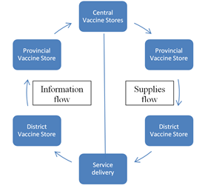
Vaccine Distribution Flow Chart

Slide 19
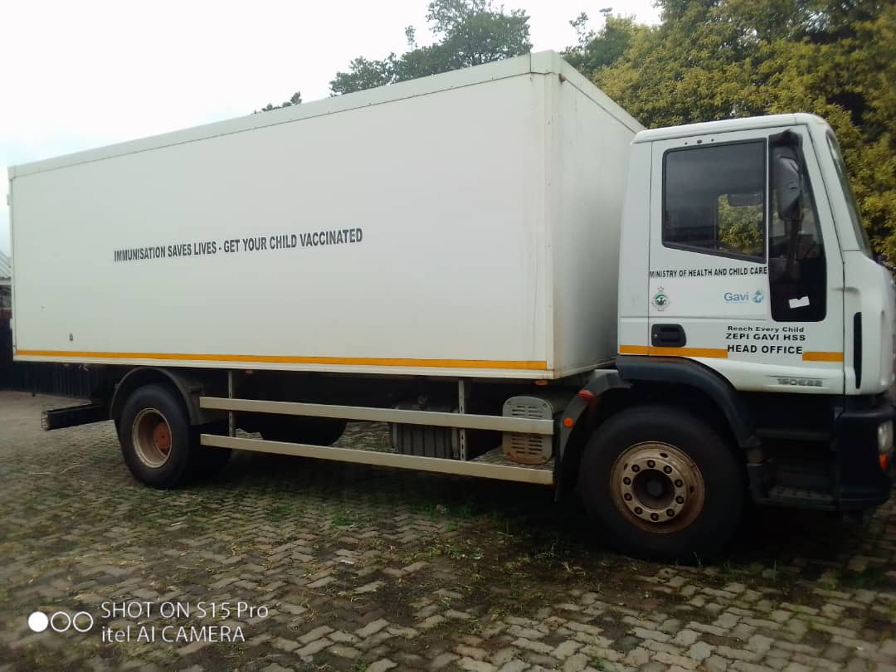

Slide 20
Supply Chain
Distribution planning is based on target population per province
Ensure adequate supply of potent vaccine to all eligible populations
Ensure functional cold chain equipment at all levels
There will be police escort accompanying ZEPI distribution vans
Distributed to provincial cold rooms with capacity of 9m³ under police escort
Distributed to districts with cold chain capacity of an average 200 litres( 2-3 refrigerators)
Logistical support for vaccine distribution & cold chain management throughout the period from planning to implementation
Supply fuel for central level & provincial standby generators

Slide 21
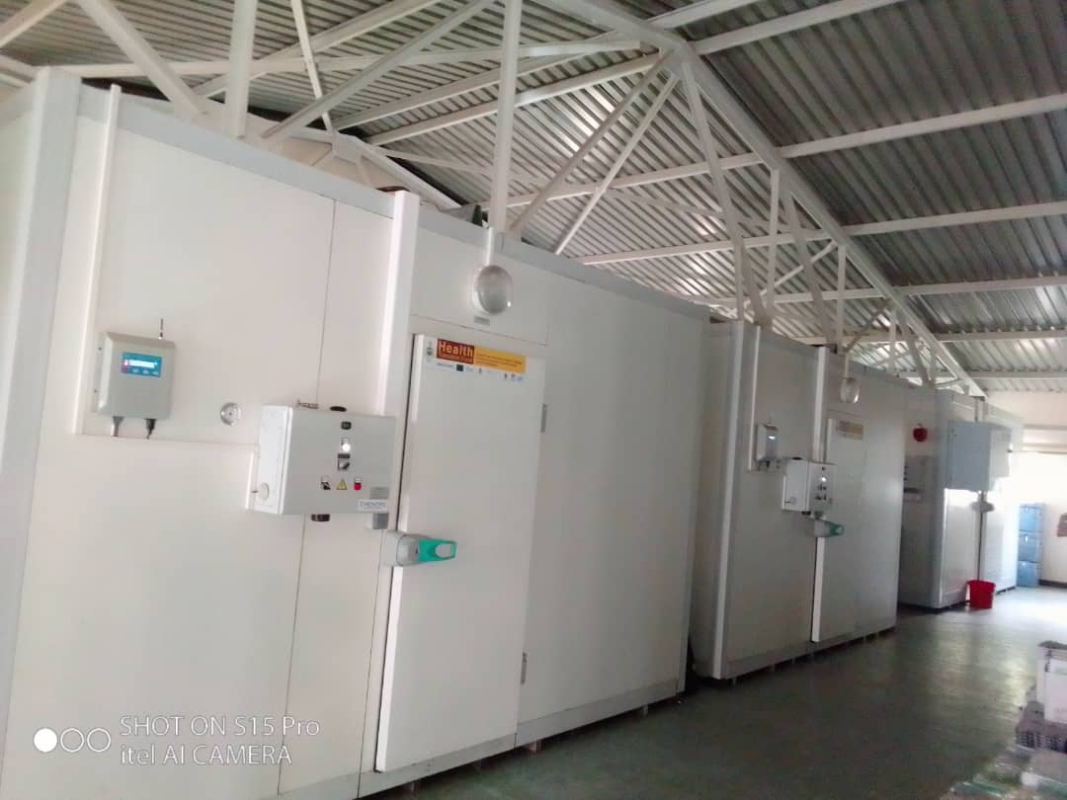

Slide 22
Cold chain Capacity Description
Level of Service | Description | Net Capacity | Average Age
National | Zhendre WICR Haier WICR metres Walk In Freezer Room | 8 – 10 m³ 8 – 10 m³ 8 m³ | 8 8 30
Provincial | Haier WICR Zhendre WICR Vestfrost MK304, Vestfrost MF314 Electrolux CH46OE | 8 m³ 8 m³ 105 litres 218 litres* 442 litres | 8 8 15 15
District | Dometic TCW3000 AC Dometic TCW2000 AC | 150 litres** 126.5 litres** | 9 9
Service Delivery Level | SunDanzer BFRV50 True Energy BLF100 Sibir V110GE Electrolux RCW42 | 54 litres 99 litres 32 litres 24 litres | 4 6 15 20

Slide 23
Information Dissemination ( Advocacy Communication and Social Mobilization)
Advocacy meetings and activities to be conducted at all levels
National vaccination launch to be conducted virtually to rally all stakeholders for COVID 19
Social Mobilisation done at all levels in order to create demand for the vaccine
Community mobilisation for vaccination will be conducted via
  Radio and TV programs & announcements
  Interpersonal communication with target groups
  Newspapers articles and advertisements
  Social media campaigns; Facebook, Whattsapp, Twitter
  Bulk SMSes
  Billboards, banners, posters and body media
Crisis Communication – addressing serious AEFIs

Slide 24
Vaccine Safety Monitoring and Management of AEFI and Injection Safetya
In partnership with MoHCC- ZEPI, the National Pharmacovigilance & Clinical Trials Committee, MCAZ, are the main drivers of vaccine safety surveillance
COVID-19 vaccine safety surveillance will be guided by already existing MoHCC’s Adverse Events Following Immunization (AEFI) surveillance guidelines and the WHO COVID-19 vaccines safety surveillance manual.
Safety surveillance for COVID-19 vaccine will be further strengthened through additional:
  Training of national stakeholders and investigation teams
  Training of national AEFI committee on causality assessment of adverse events following COVID-19 vaccination
  Training and preparation of health care workers on identification, management and reporting of potential cases of anaphylaxis and ensuring availability of comprehensive emergency tray at all vaccination points.
  The trainings will be provided as part of a comprehensive COVID-19 vaccine introduction trainings.
Instituting active surveillance of Adverse Events of Special Interest following COVID-19 vaccination.

Slide 25
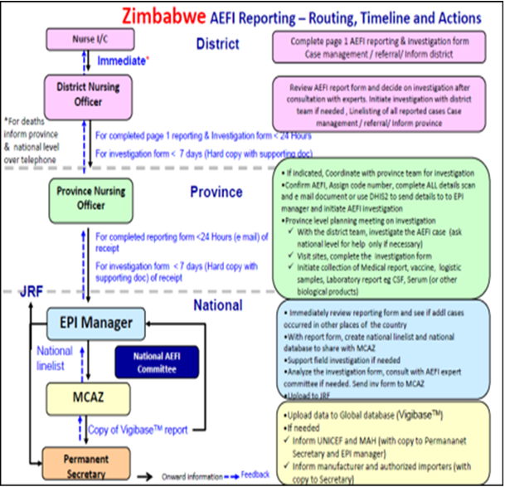
ZIMBABWE AEFI REPORTING

Slide 26
Biohazard and immunization waste management
Management of waste related to COVID-19 vaccination requires special attention due to the infectious nature of the virus.
Waste generated from Covid-19 vaccination will be according to the country’s existing waste management guidelines for treatment of health waste.
There will be waste segregation at point of generation following existing protocols.
All medical waste will be incinerated either at point of generation if there is a functional incinerator or at some central incineration point in which case transport will provided to move the waste to the incineration point.

Slide 27
MONITORING & EVALUATION
Development of an M & E Framework to guide planning & implementation
There will be pre vaccination demographic data collection
Conduct Preparedness Assessment to assess readiness at all levels
Development of data collection tools; i.e. tally sheets, summary sheets, vaccination cards
Consolidation and reporting of the number reached will be done on a daily basis using existing platforms and structures
Disease surveillance will include AEFI monitoring
There will be blood collection to determine antibodies before and after vaccination.
Conduct a Post Campaign Coverage Survey to validate administrative data
Conduct a Post Introduction Evaluation to assess the quality of the introduction of the COVID-19 vaccine and help inform future introductions

Slide 28
TENTATIVE TIMELINE OF ACTIVITIES
ACTIVITY | PERIOD
PLANNING | ONGOING
TRAINING | 12-16 FEBRUARY
PROCUREMENT | 08 -15 FEBRUARY
VACCINE DISTRIBUTION | 15-26 FEBRUARY
COLD CHAIN INVENTORY | ONGOING
ADVOCACY, COMMUNICATION & MOBILISATION | FROM 08 FEBRUARY
MONITORING & EVALUATION | FROM 08 FEBRUARY
VACCINATION | 18 FEBRUARY

